Slide 1

Agentic AI Vulnerabilities
Faishal Youshuf - 101044804

Slide 2
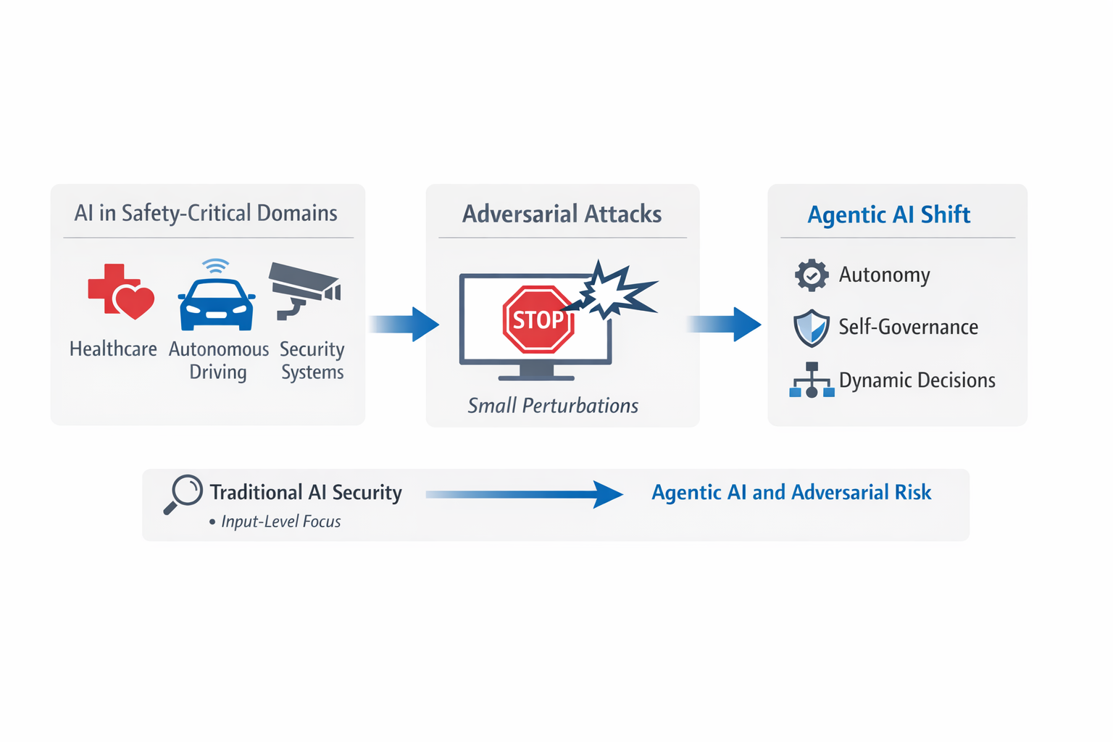


Introduction
AI used in healthcare, autonomous systems
Vulnerable to adversarial attacks
Small perturbations → incorrect outputs
Shift from static AI to agentic AI
Includes autonomy and self-governance
Notes:
Agentic AI is increasingly being used in safety-critical domains such as healthcare, autonomous driving, and security systems, where accuracy and reliability are extremely important. However, these systems are vulnerable to adversarial attacks, where even very small and often unnoticeable changes in input can lead to incorrect or misleading outputs. Traditionally, AI security has mainly focused on protecting against these input-level attacks. But with the rise of agentic AI, systems are no longer just passive—they can act independently, make decisions, and continuously interact with their environment. This shift toward autonomy, self-governance, and dynamic decision-making makes these systems more powerful, but also introduces new layers of complexity. As a result, the attack surface expands, and the risks become greater, requiring more advanced and holistic security approaches.

Slide 3
Expanding Threat Landscape in Agentic AI
Closed-loop decision-making systems
Multi-layer vulnerabilities
Perceptual, Cognitive, Executive layers
Attacks propagate across layers
No single defense is sufficient
Notes:
Agentic AI systems operate through continuous feedback loops, where they constantly perceive their environment, make decisions, and take actions. Because of this, vulnerabilities are not limited to just the input level—they can affect multiple layers of the system, including perception, reasoning, and execution. For example, an attacker might manipulate inputs, influence the system’s decision-making process, or even control its final actions.
Another challenge is that these attacks can propagate across layers and accumulate over time through feedback, making the impact more severe. This creates a much more complex threat landscape compared to traditional AI systems. As a result, relying on a single defense mechanism is not enough, and securing agentic AI requires a more comprehensive, multi-layered approach.

Slide 4
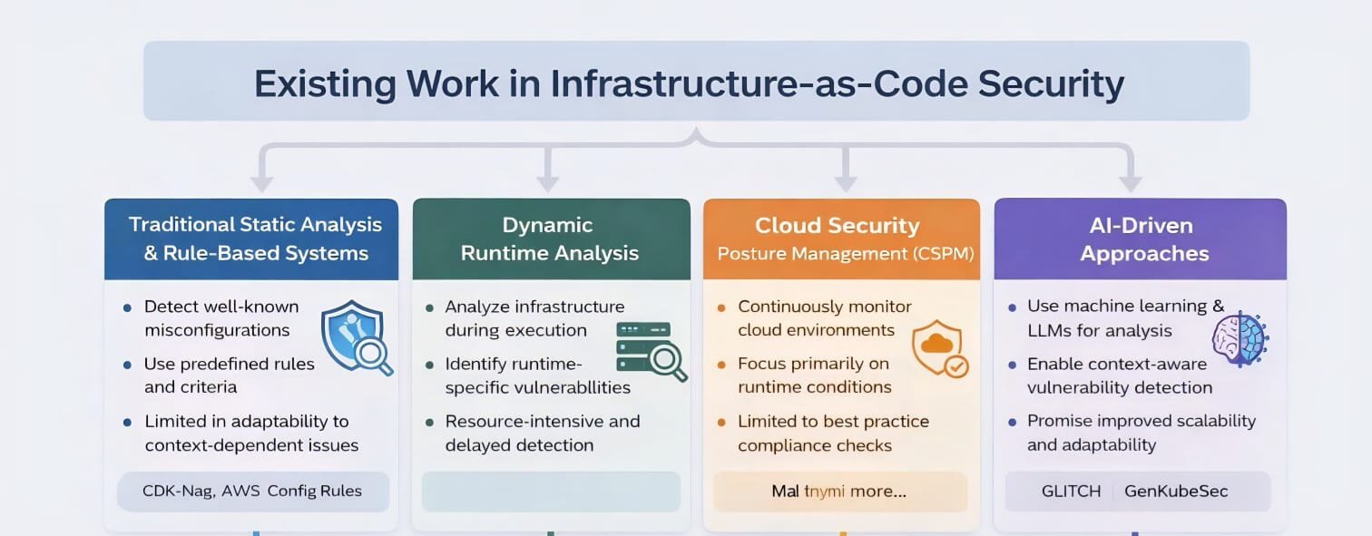
Related work
Notes:
The image presents an overview of existing approaches for securing Infrastructure-as-Code (IaC), highlighting four main methods: traditional static analysis, dynamic runtime analysis, Cloud Security Posture Management (CSPM), and AI-driven approaches. Traditional static and rule-based systems are effective at identifying known misconfigurations using predefined rules, but they struggle with complex, context-dependent issues and lack adaptability. Dynamic runtime analysis, on the other hand, examines systems during execution and can detect runtime-specific vulnerabilities, but it is resource-intensive and often identifies issues too late. CSPM tools continuously monitor cloud environments to ensure compliance with best practices; however, they mainly focus on runtime conditions and do not address vulnerabilities during the development phase. More recently, AI-driven approaches, including machine learning and large language models, have been introduced to enable context-aware detection and improve scalability. Despite these advancements, the image highlights that no single approach is sufficient, and there is a need for an integrated solution that combines multiple techniques to effectively address modern security challenges in IaC systems.

